Slide 1
Senior Picnic
5/20/22

Slide 2
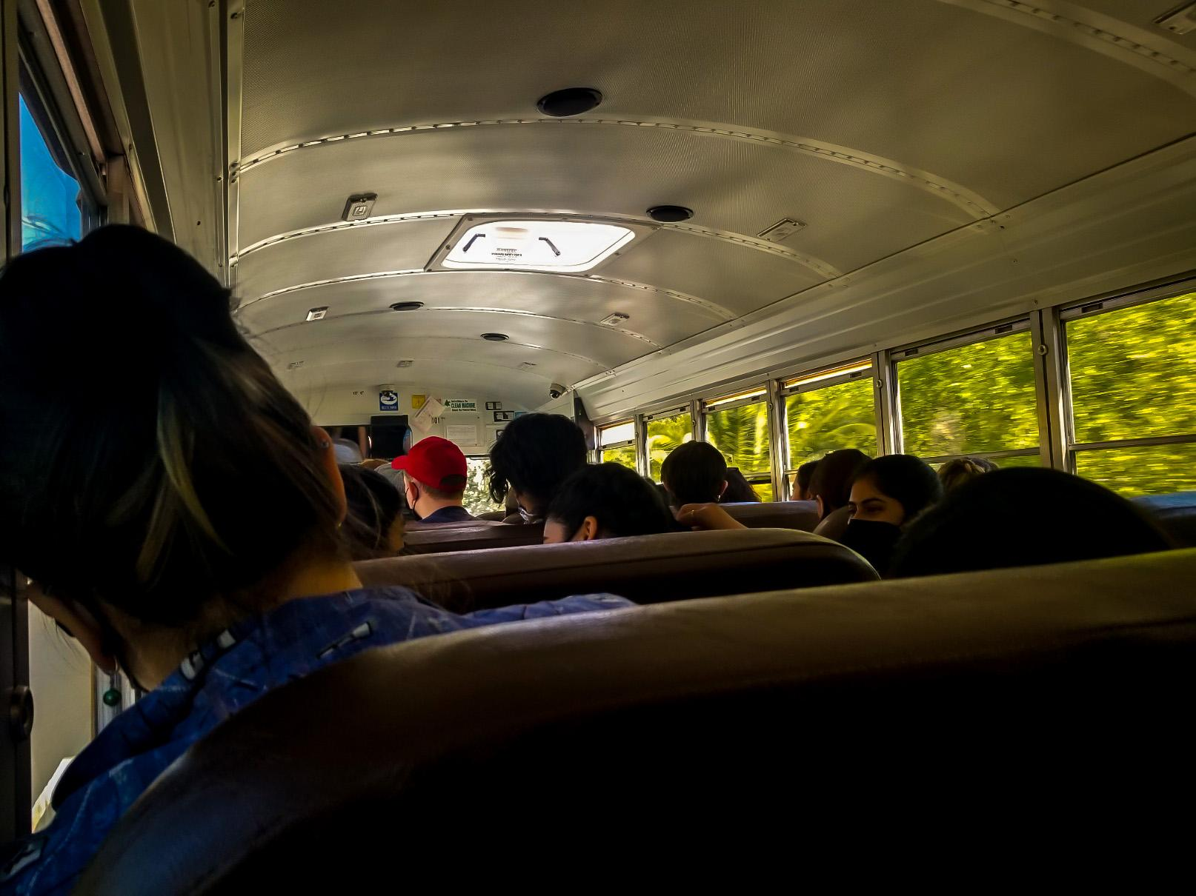
Bus ride to Six Flags

Slide 3
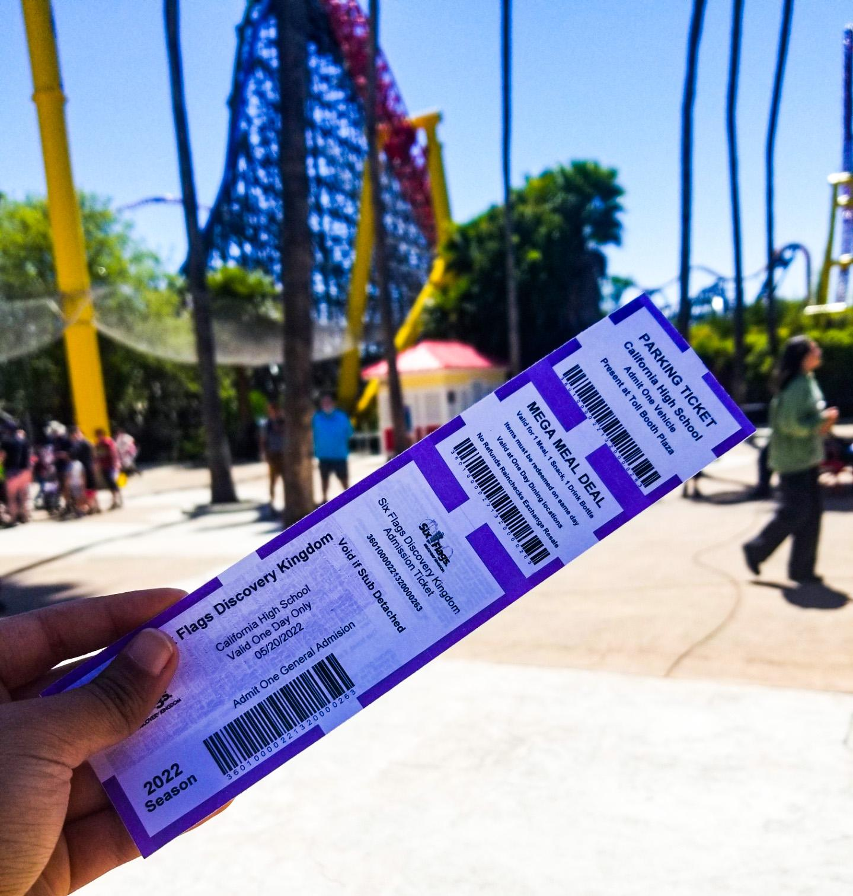
Six Flags ticket

Slide 4
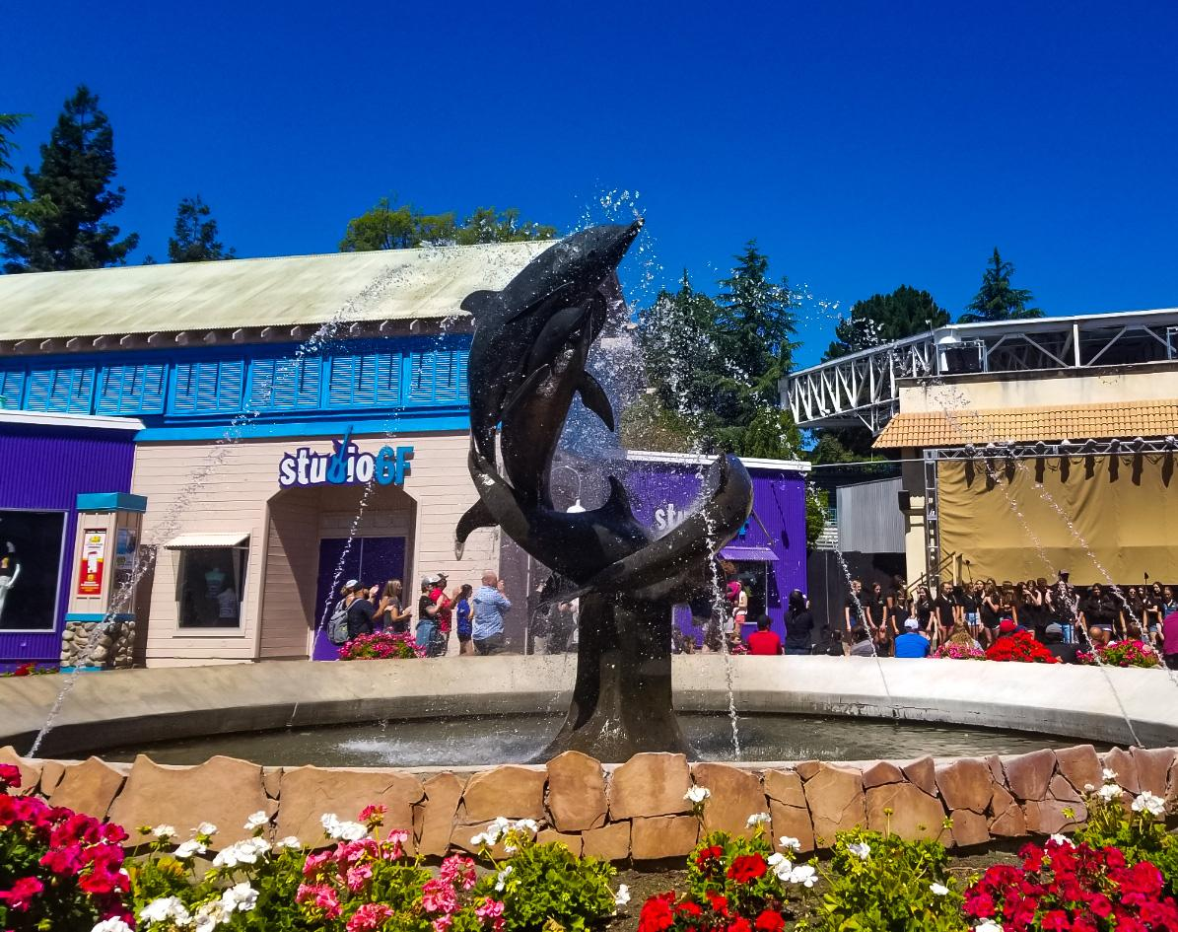
Dolphin fountain at the entrance

Slide 5
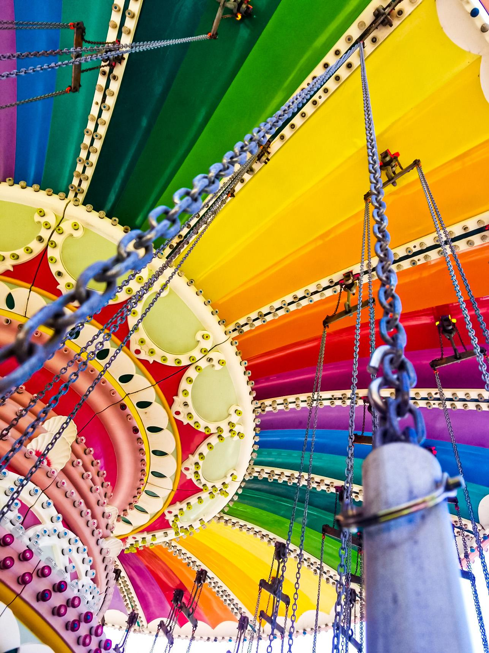
Colorful swing ride

Slide 6
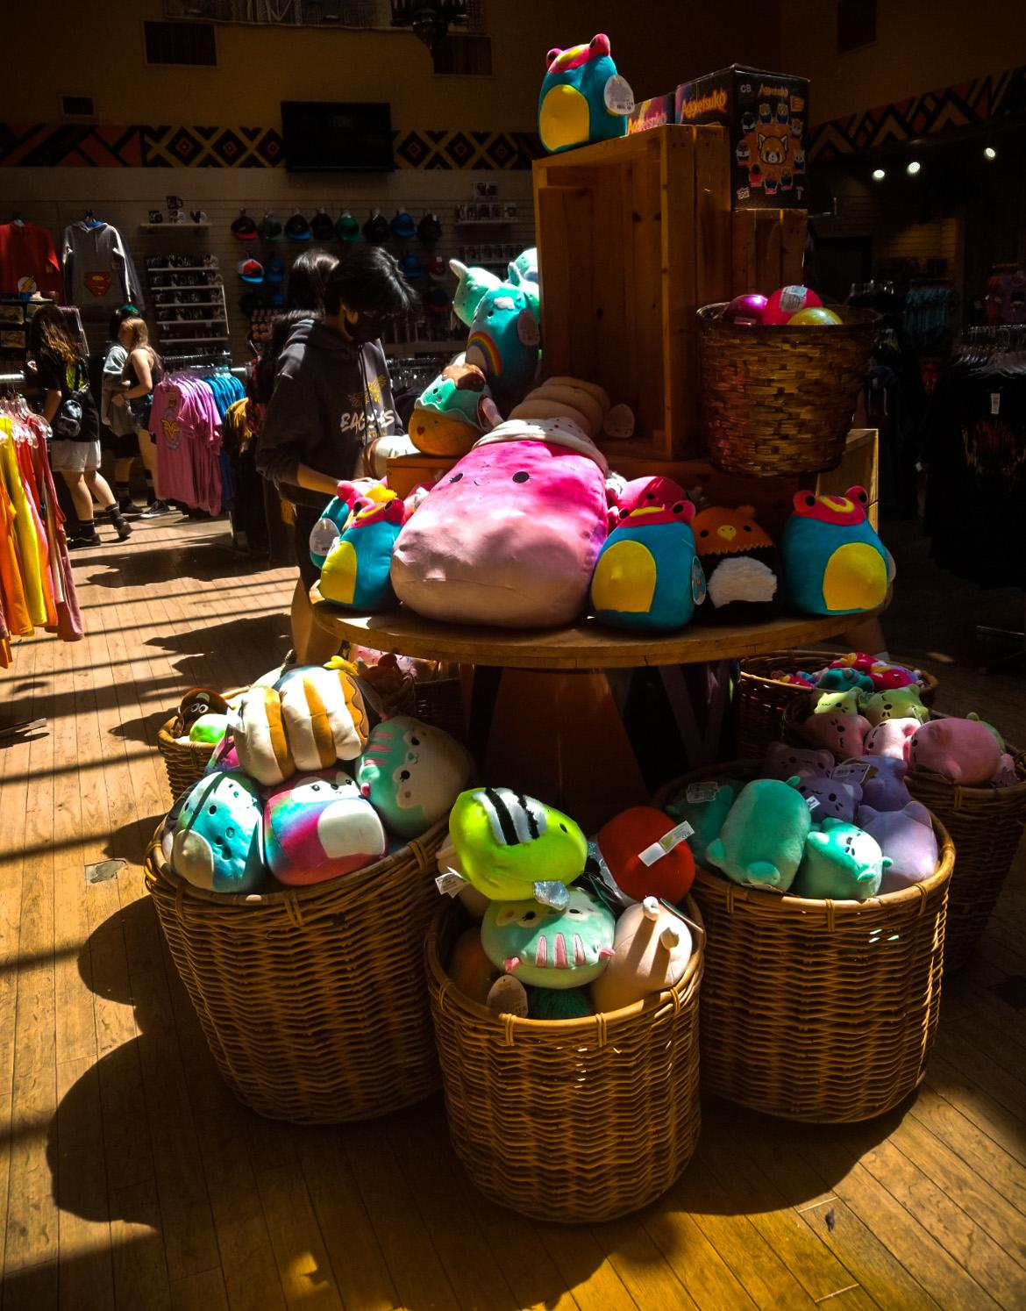
Cute stuffed animals for sale!

Slide 7
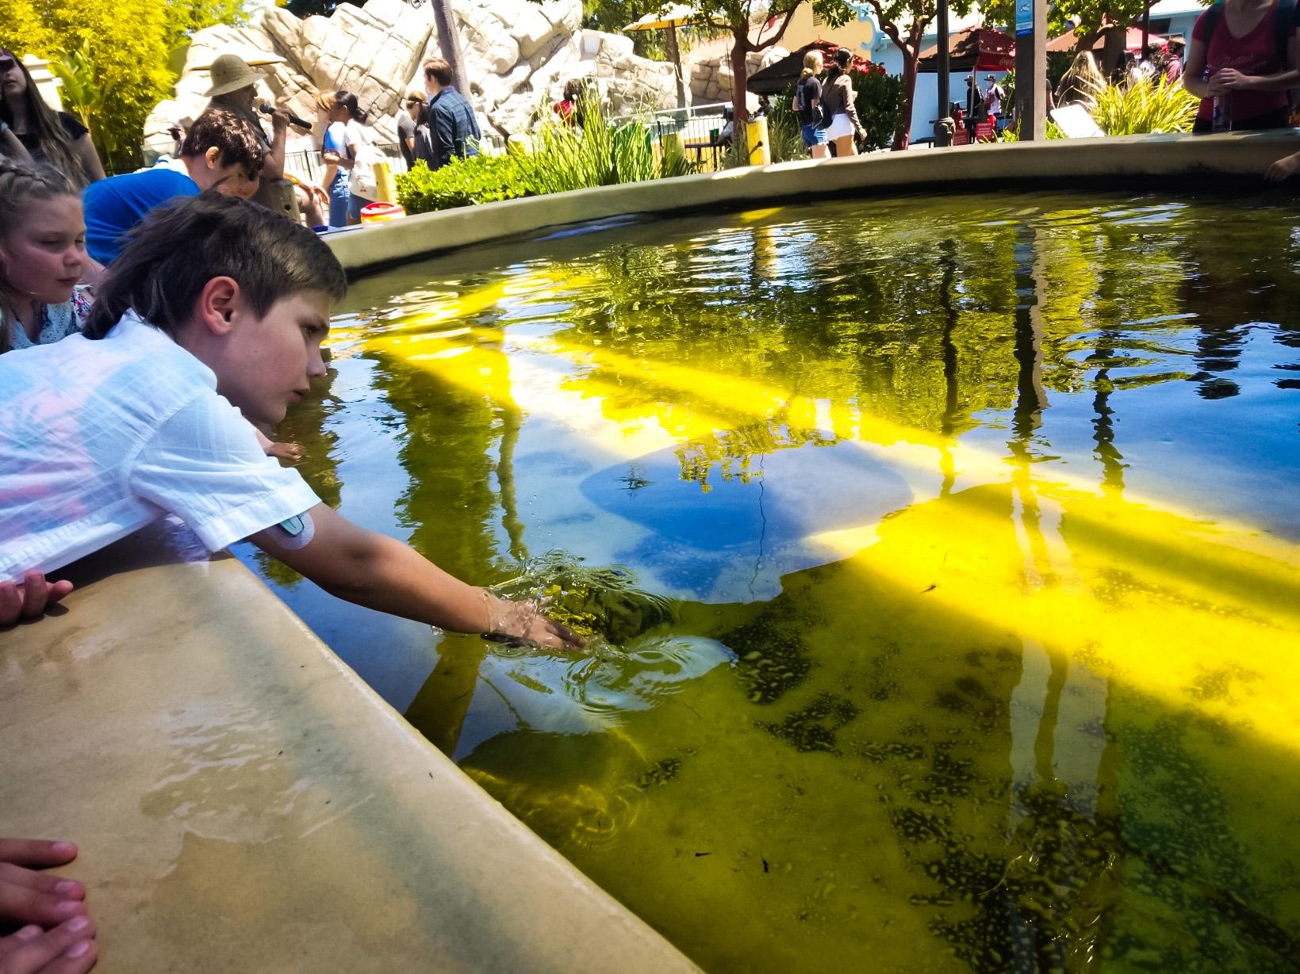
Child reaching out to touch stingray.

Slide 8
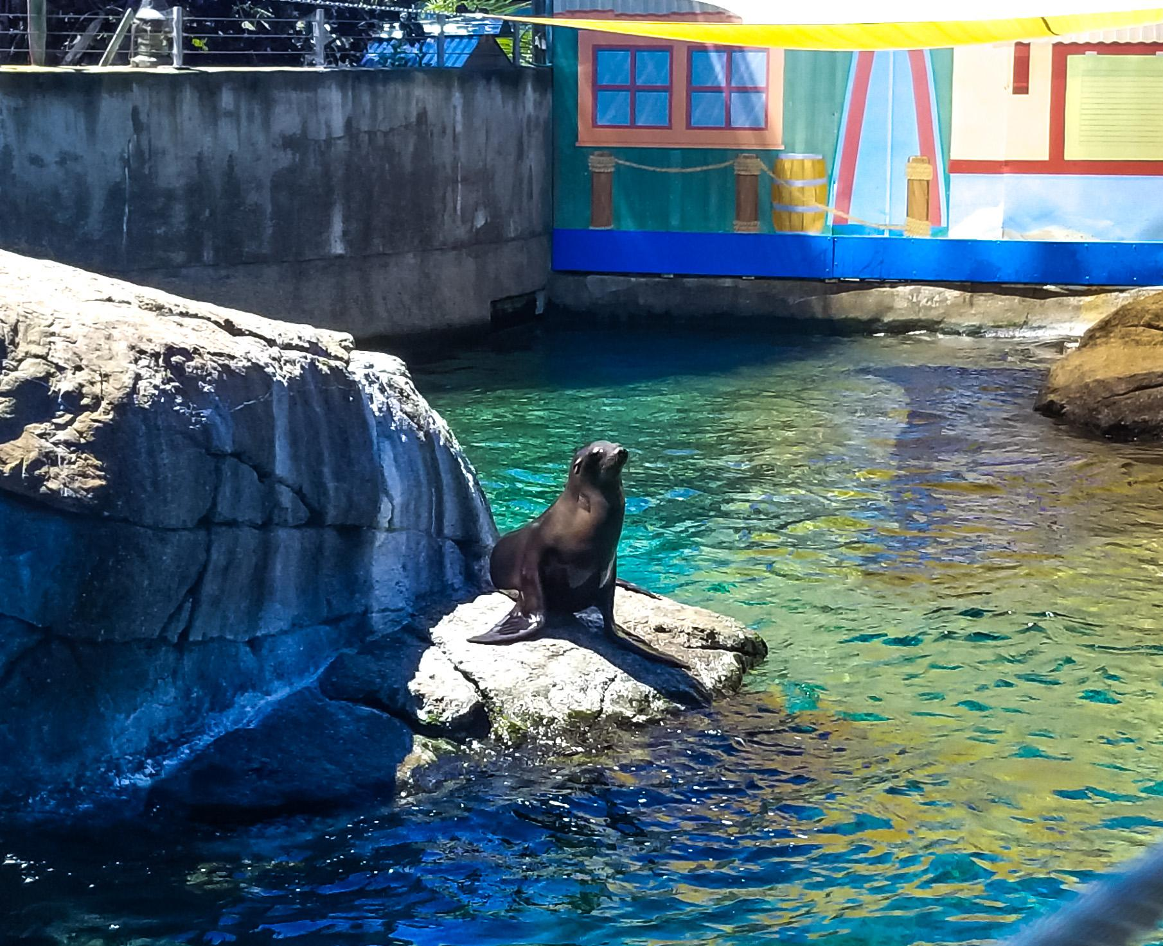
Seal awaiting food.

Slide 9
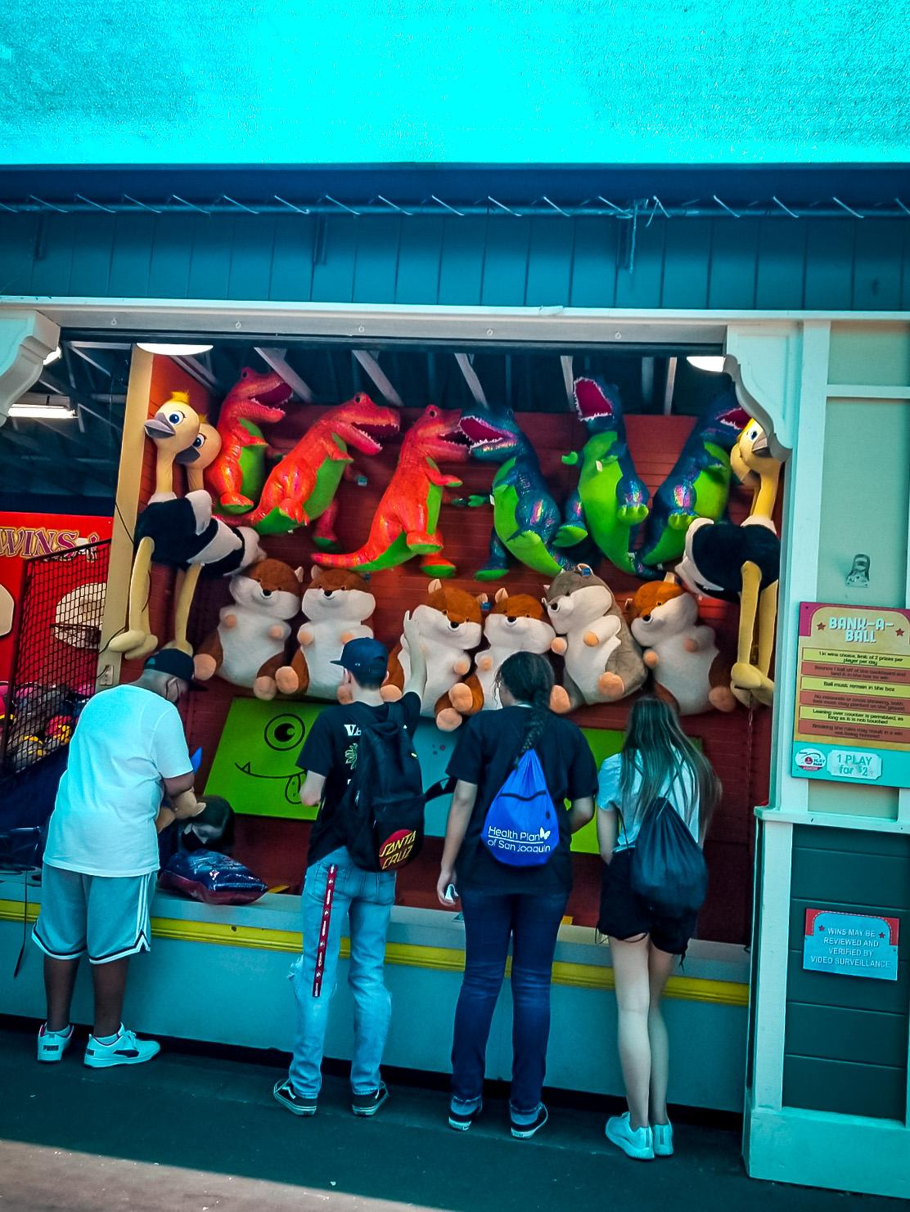
Fun carnival game

Slide 10
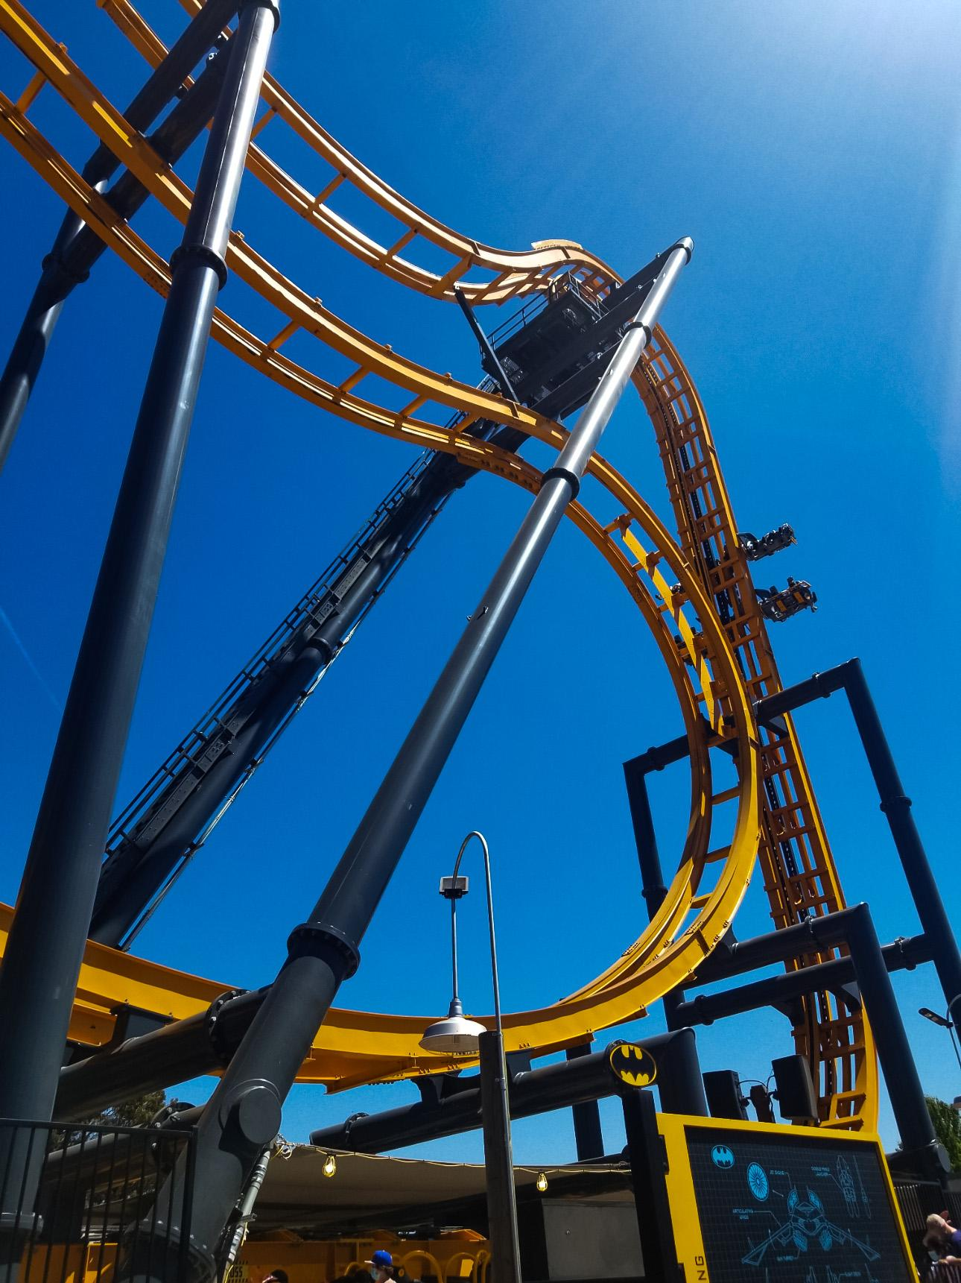
BATMAN: The Ride

Slide 11
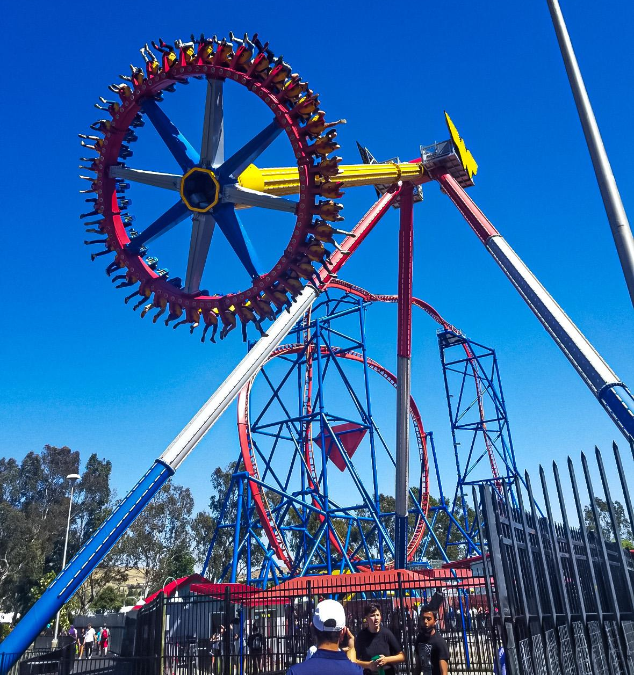
WONDER WOMAN Lasso of Truth

